Slide 1


TRIPLE INS’ GROCERY
224416M, Ying Jing
221411J, Ke Xin
Notes:
KX(1)
Good morning/afternoon everyone, my name is Ke Xin and I am here with my team Ying Jing. Today we are here to present to all of you our online ordering and payment system. Our store name is called Triple Ins’ Grocery.

Slide 2
Members | Contributions | Strengths
Ying Jing | Code - SignUp/Login - View Menu - Place Orders - View Orders Placed - Remove Existing Items - Feedback Others - Flowchart (SignUp/Login, View Menu, Place Orders, Feedback/Review) - Powerpoint Slides & Report | - Using Functions, Lists, Conditional Statements, global and local variables - Debugging Errors - Make the program more user-friendly - Organizing Flowchart, Report, and Powerpoint Slides
Ke Xin | Code View Menu Payment/Checkout Others - Flowchart (View Orders, Remove Items, Payment/CheckOut, Receipt) - Powerpoint Slides & Report | - Calculations for payment/checkout - Detailed payment/checkout process - Debugging errors - Using lists, Conditional Statements, global and local variables
Notes:
CONTRIBUTIONS & STRENGTHS SLIDES
YJ(1)

Slide 3

OBJECTIVES OF PROGRAM
To create a more user-friendly and responsive online ordering and payment system for the users.
Allow customers to order their groceries online rather than physically going to the supermarket.
Create brand awareness
Assist people who have difficulties leaving their home.
Notes:
YJ (1st 2)
KX (last 2)

Slide 4
PROGRAM REQUIREMENTS
View menu items according to Alphabetical, Price, Category Order
Shows respective items in category with prices when user select a category.
Specifying the quantity order user wants to buy.
Allow user to select multiple grocery items from various categories and add them to cart.
Able to remove existing items.
Prompting user if they have discount card
If yes, 10% discount off the total ordered amount.
Presented a formatted bill (total price, total discount, gst and final payable) with summary of all ordered items and prices
Notes:
YJ (1st 4)
KX (last 4)

Slide 5
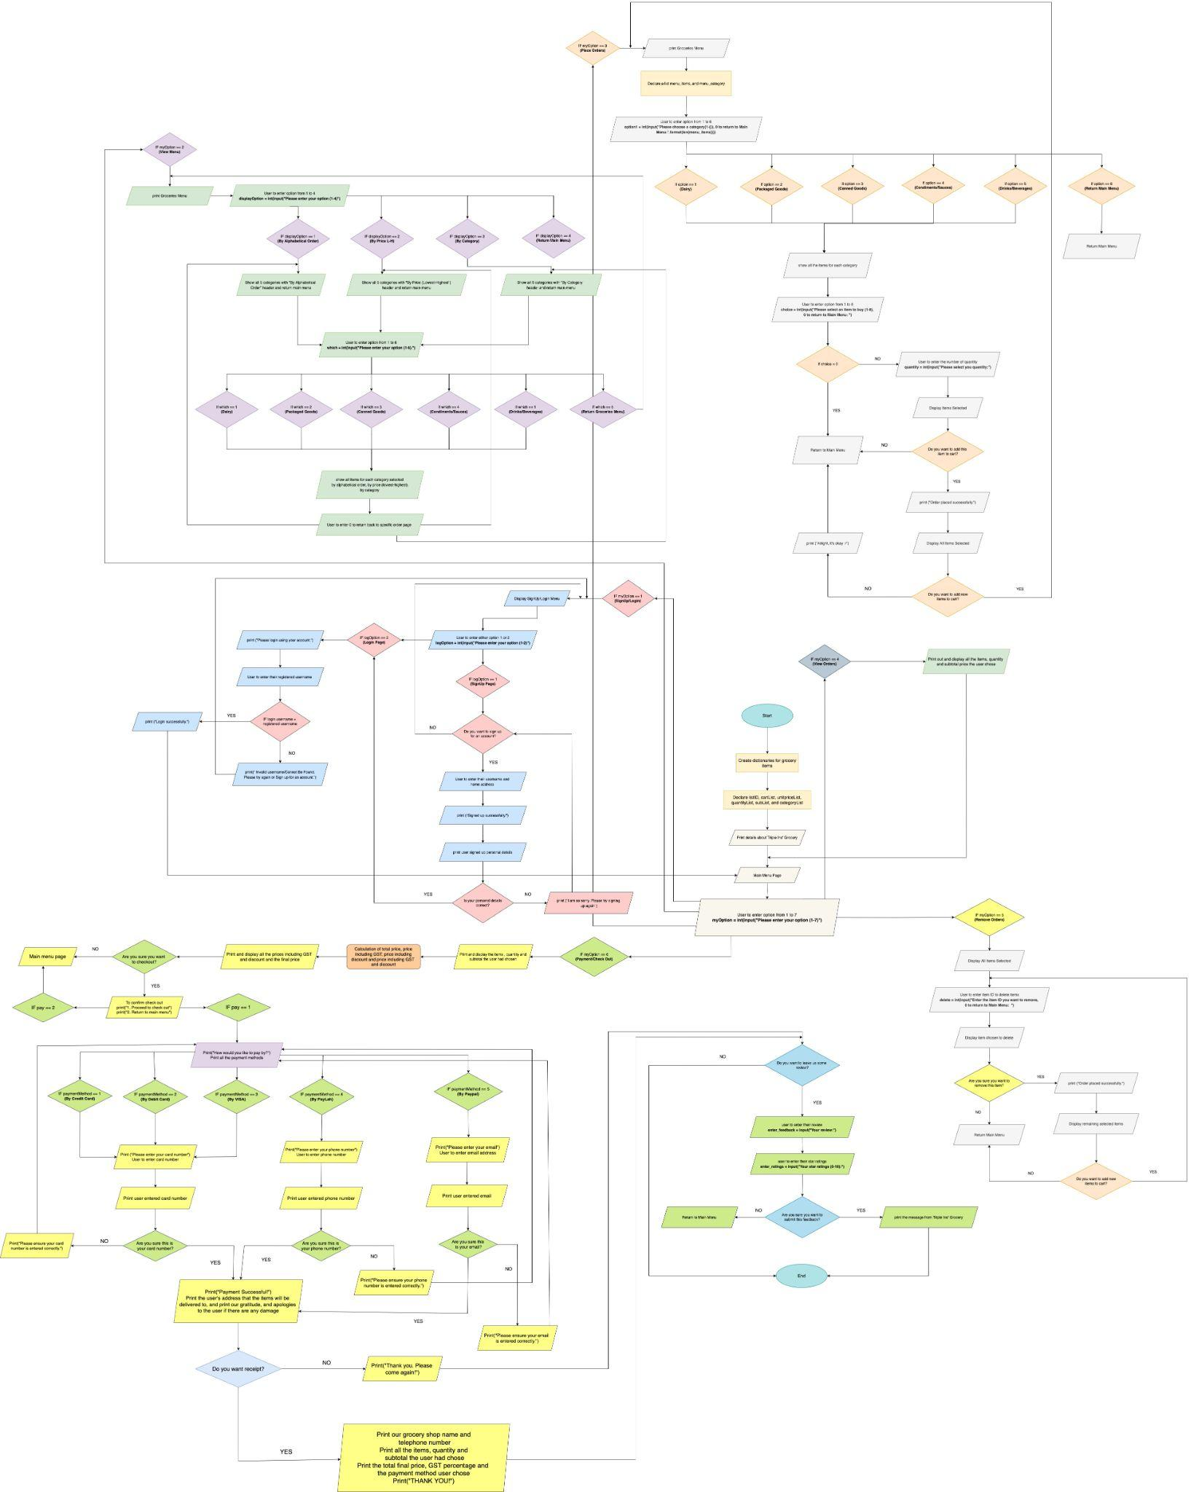
FLOWCHART
Notes:
FLOWCHART
YJ(3)

Slide 6
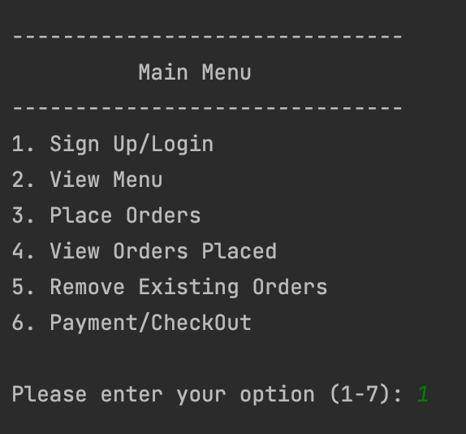
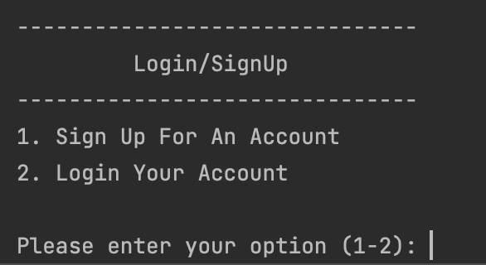
EXPLANATION OF PROGRAM DESIGN
START/LAUNCH
User are able to choose any option from 1 to 6
User must sign up/login in order to place orders
LOGIN/SIGNUP
Notes:
YJ

Slide 7
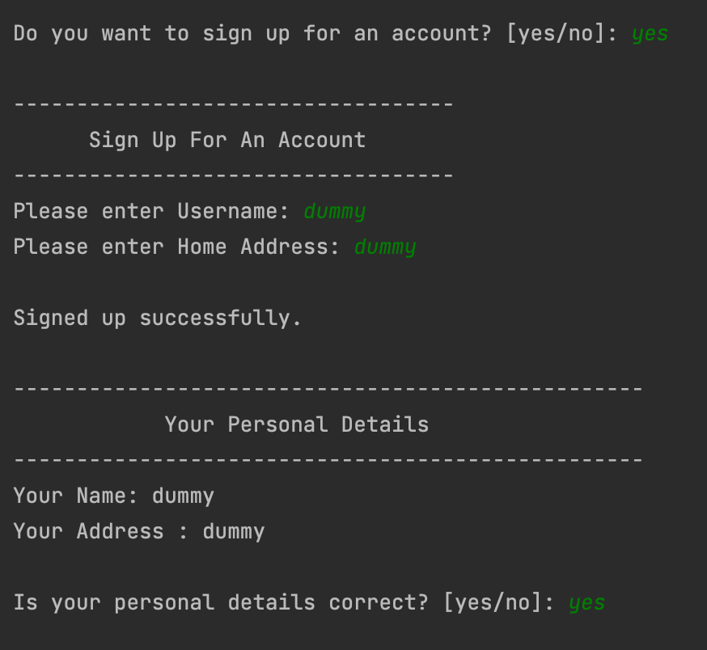
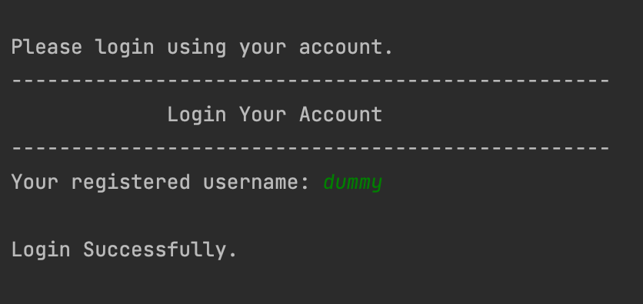
SIGN UP
Ask user if want to sign up
Ask user to enter username and home address
Ask user if personal details is correct
Login to access full feature using registered username
LOGIN

Slide 8
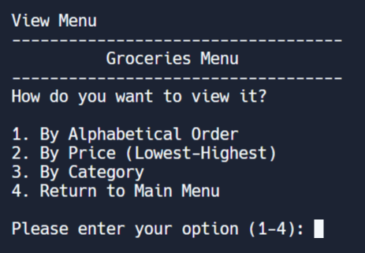
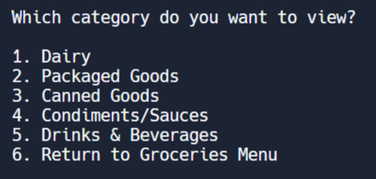
VIEW MENU
User can choose how they
want to view the menu
After the user choose how they want to view it, they will select which category they want to view it in
Notes:
View menu

Slide 9
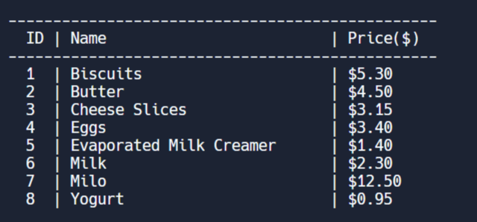
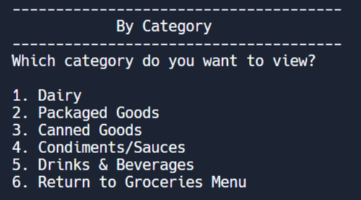
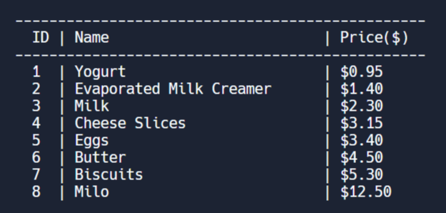
EXAMPLE OF VIEWING DAIRY
BY ALPHABETICAL
BY CATEGORY
BY PRICE (LOWEST TO HIGHEST)

Slide 10
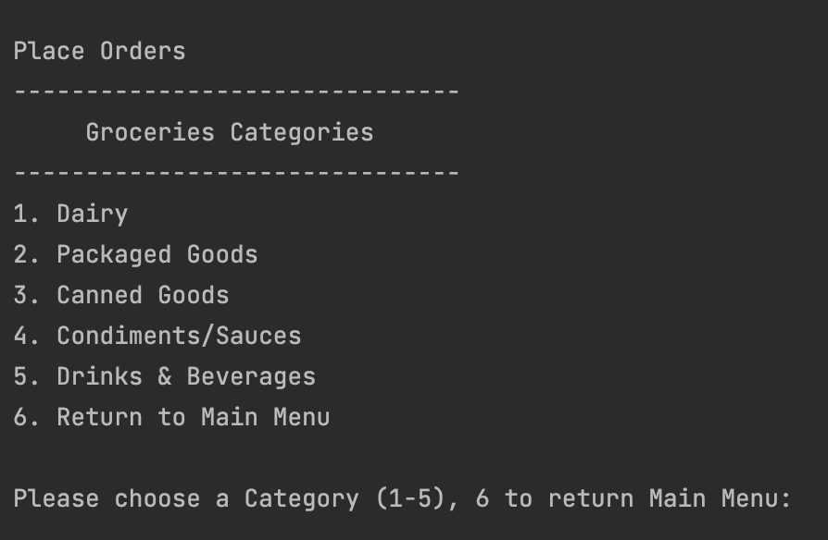
PLACE ORDER
User are able to choose any option from 1 to 5 to view the items,
6 to return main menu

Slide 11
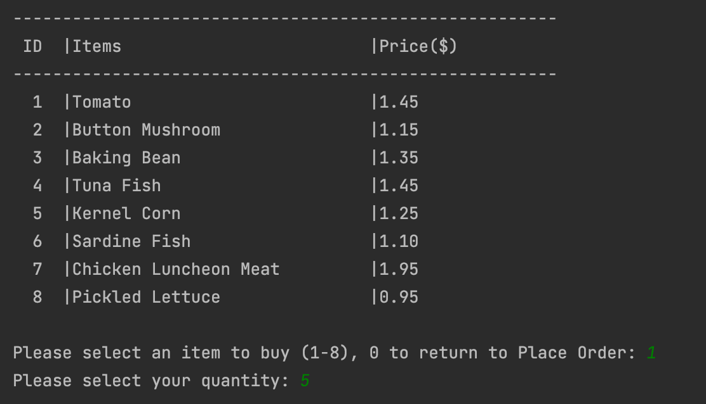
EXAMPLE OF CHOOSING CANNED GOODS
Ask user to select an item to buy or return to the Place Order Page
Ask user to enter the number of quantity if they want to buy any item

Slide 12
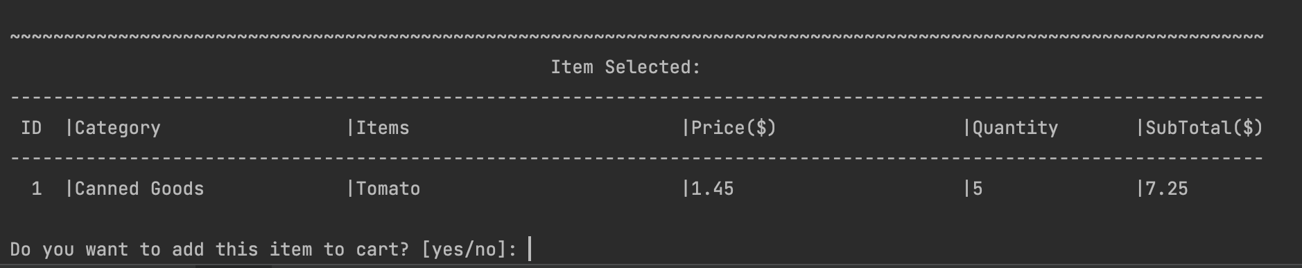
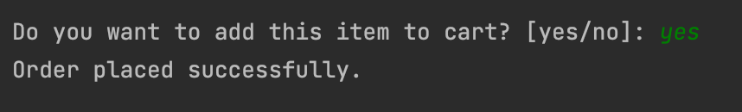
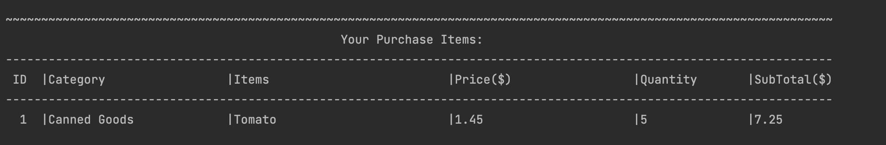
Show the item user had selected
Ask user if want to add to cart
If yes, show added items
If no, go back to main menu

Slide 13
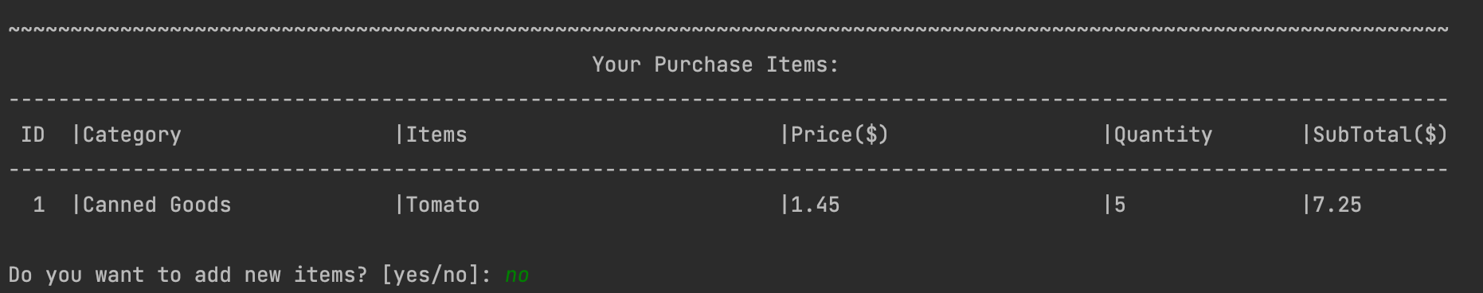
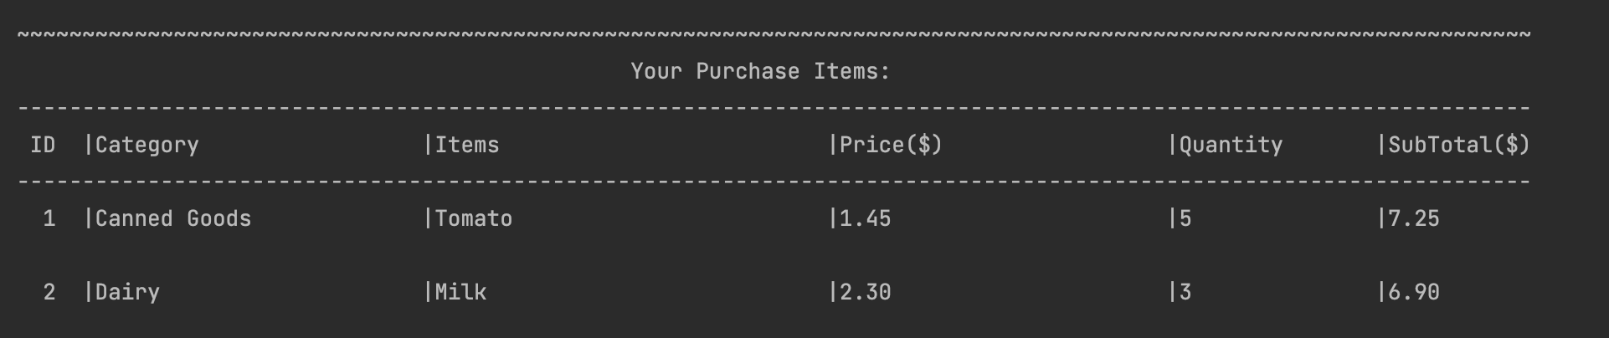
ADDING NEW ITEMS
Ask user if want to add new items
Show all the items user had added previously and currently
If yes, go back the place order procedure
If no, back to main

Slide 14
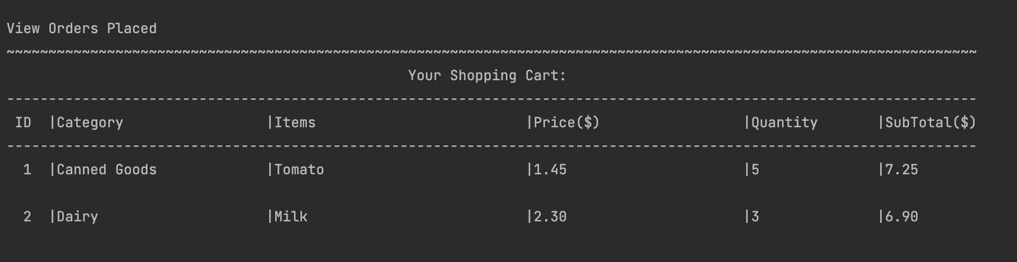
VIEW ORDERS PLACED
Show user all their orders placed when they select View Orders Placed option

Slide 15
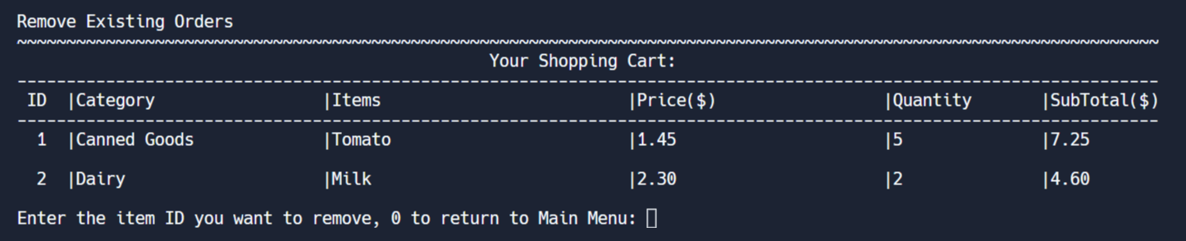
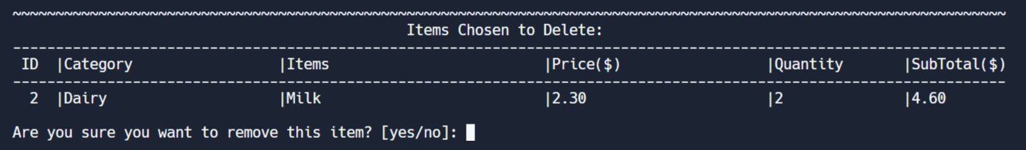

REMOVING ITEMS FROM CART
User can enter the item ID that they want to remove
EXAMPLE OF REMOVING MILK
If user choose yes
User’s selected item to remove
User will be asked to confirm if they
want to remove the selected item

Slide 16
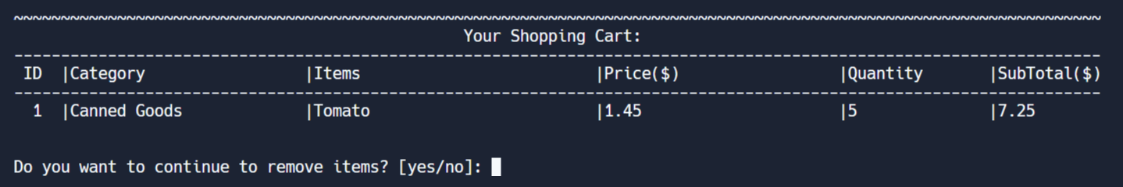
Updated items in the list after removing the selected item
User can choose if they want
to remove item again
If user choose yes,
continue to remove
If user choose no,
back to main menu

Slide 17
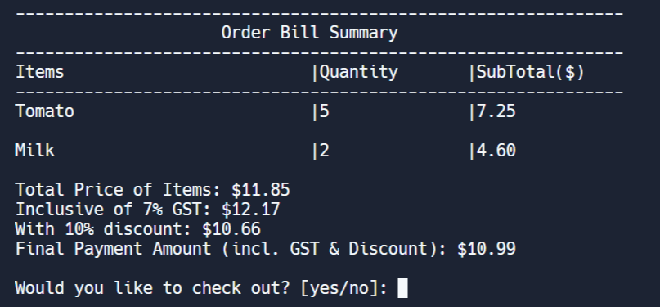
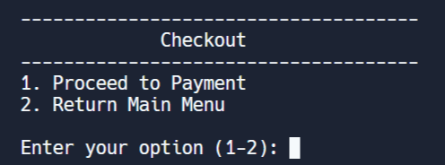
CHECKING OUT
Show all the items the
user wants to buy
Display all the prices, with GST, discount and final total
If user enter no,
return to main menu
User will be asked if they
want to confirm check out

Slide 18
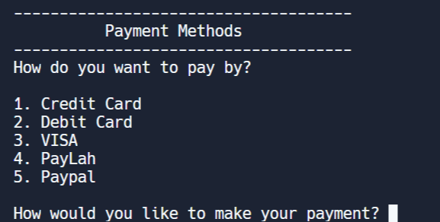
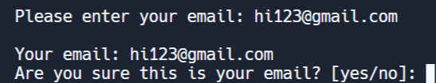
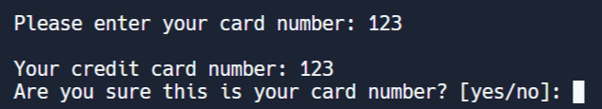
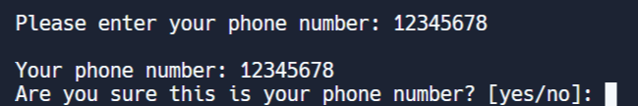
User will be asked which method they will use to make payment
User are to confirm if their entered details are right
User are asked to enter their card/phone number/email
If confirm is no, back to payment method
PAY BY PAYPAL
PAY BY CREDIT, DEBIT AND VISA
PAY BY PAYLAH

Slide 19
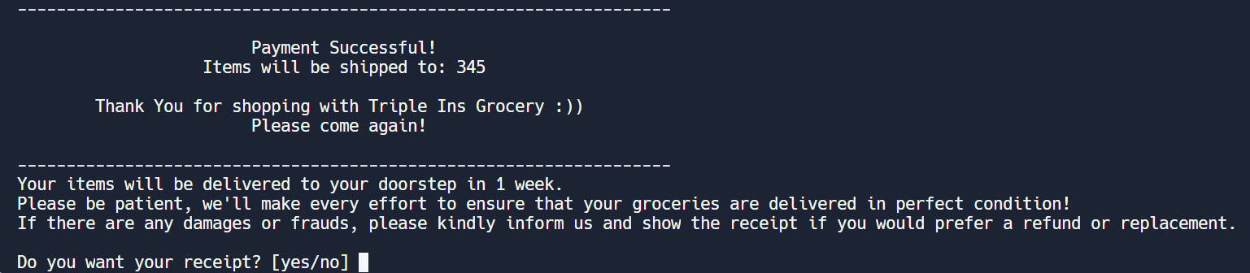
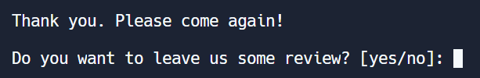
SUCCESSFUL PAYMENT TRANSACTION
Showing our gratitude to the user who bought our items
Ask if the user want receipt
IF USER ENTER NO
User would be asked if
want to leave feedback

Slide 20
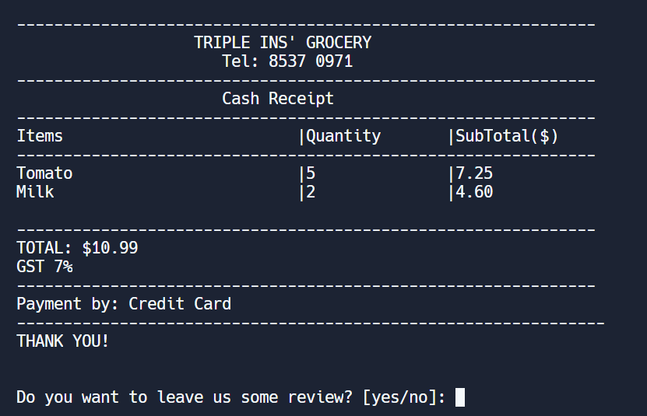
Our grocery’s name and telephone number
IF USER WANTS THE RECEIPT
All the items and the total price of the items
the user buy and the payment method
Ask if the user wants
to leave review

Slide 21
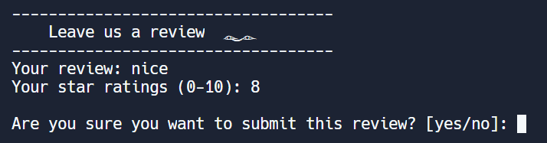
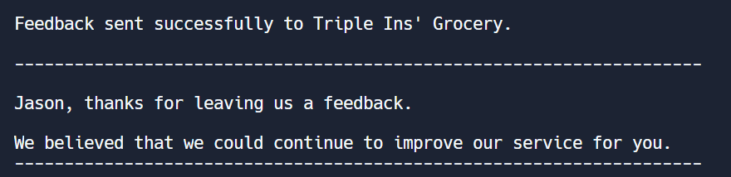
REVIEW
User are asked to give their review and ratng
To confirm submission
If user submit review, it will state the feedback was sent to Triple Ins’ Grocery

Slide 22
TESTING AND RESULTS
We will demo the testing and results on Pycharm.
Notes:
For the testing and results, we will demo on the pycharm

Slide 23
EXTRA FEATURES IMPLEMENTED
SignUp/Login
Allow user to sign up their account and address before they can login using their username to buy their groceries.
Invalid Username return user back to SignUp/Login Menu.
Feedback/Review
Allow user to leave a feedback after or before payment was made.
Able to leave feedback only if user had signed up for an account.
Payment Methods & Receipt
Allow user to do online payment gateway (such as credit/debit cards, VISA, PayLah, and PayPal) and giving receipt
Able to do online payment only if user had signed up for an account. The receipt can be used to request for refund or exchange.
Notes:
YJ and KX

Slide 24
CONCLUSION
Our program is to make people’s life more convenient without having to go to the grocery.
Our program includes many features that secures the safety of the user by having login and payment methods features.
Notes:
KX

Slide 25
THANK YOU
Notes:
END

